Slide 1
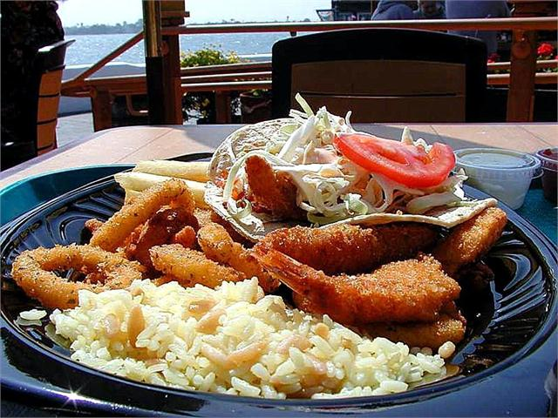
Windyridge School Canteen
Monday – Scampi and rice

Slide 2
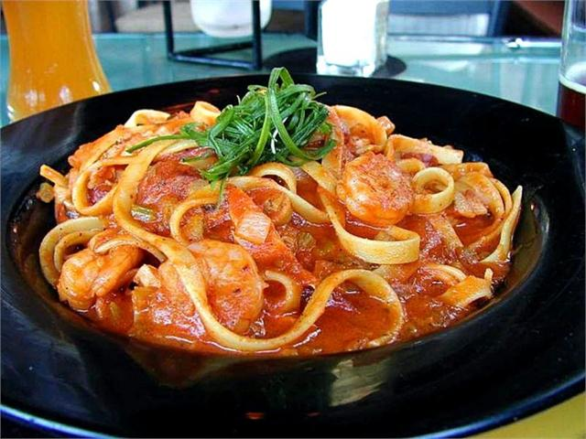
Windyridge School Canteen
Monday – Prawn pasta

Slide 3
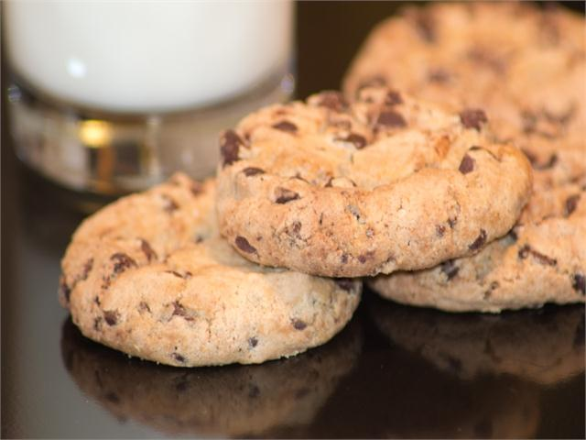
Windyridge School Canteen
Monday – Homemade cookies

Slide 4
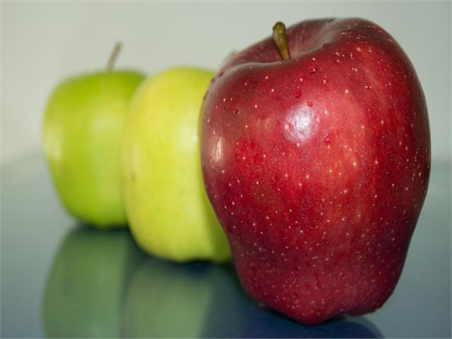
Windyridge School Canteen
Monday – Apples

