Slide 1
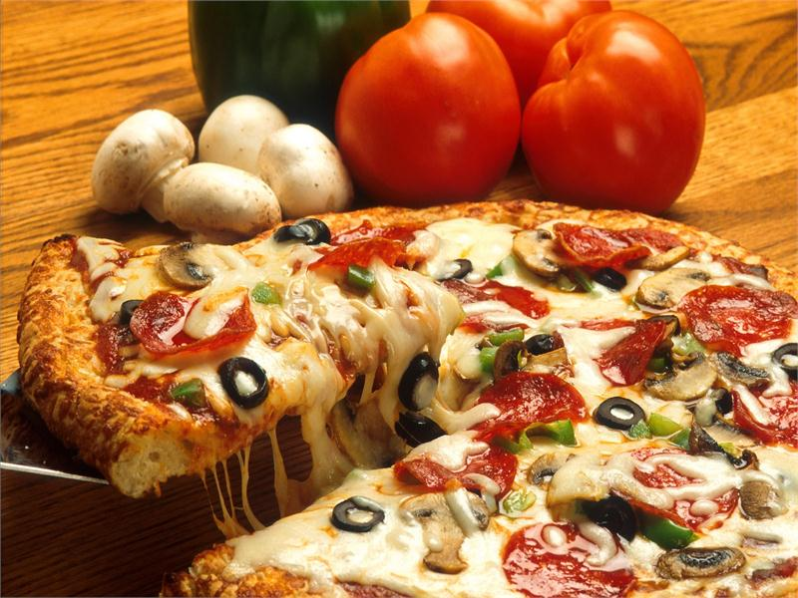
Windyridge School Canteen
Tuesday – Pizza

Slide 2
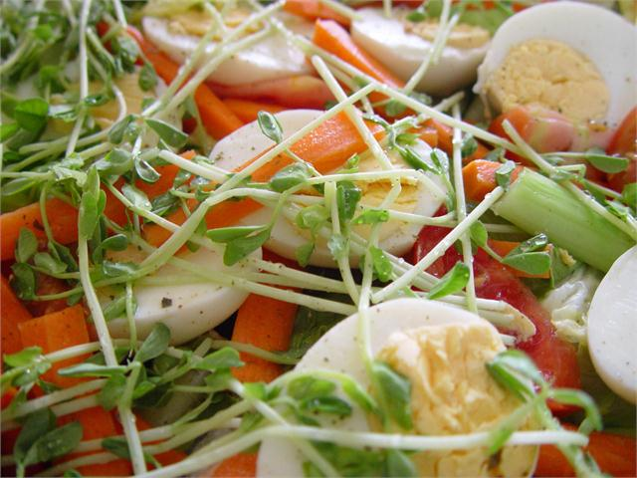
Windyridge School Canteen
Tuesday – Salad

Slide 3
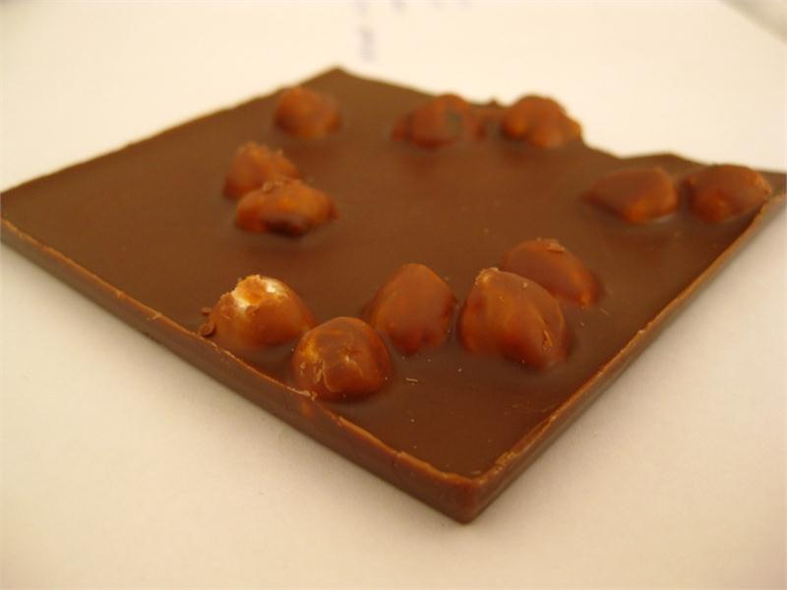
Windyridge School Canteen
Tuesday – Homemade slice

Slide 4
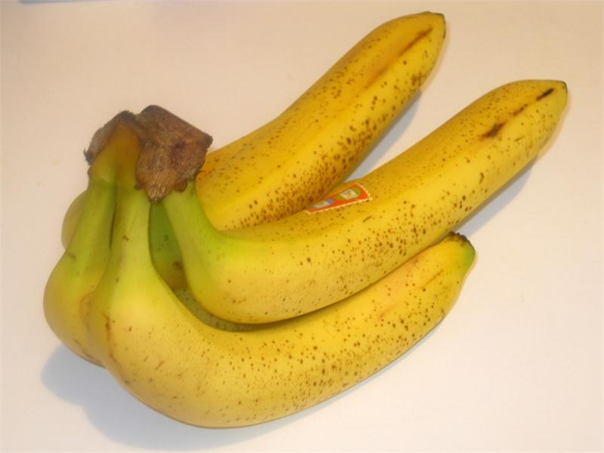
Windyridge School Canteen
Tuesday – Bananas

